Slide 1

ANDRIK SALGADO
ALFREDO MARTÍNEZ
GABRIEL ORLANDI
ALFREDO ANGELES

Slide 2
ROLES
ANDRIK: GAME MANAGER
GABRIEL: PROGRAMMERS
ALFREDO MARTÍNEZ: PROGRAMMERS
ALFREDO OJEDA: ART DESIGNER

Slide 3
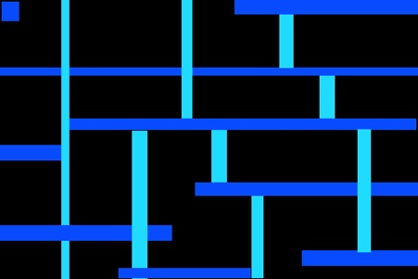
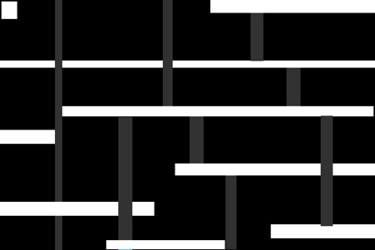
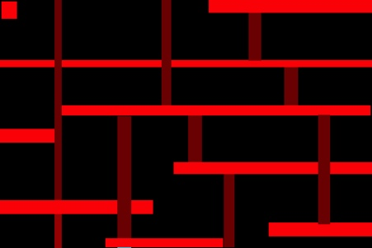
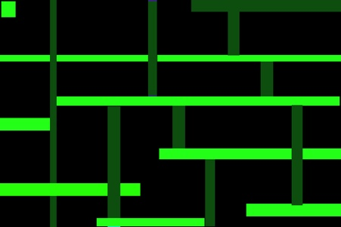
WHY OUR GAME IS UNIQUE…
Controllers and game mechanics
Innovative idea and fun to play. Drunk simulated mechanics are great.
Different challanges and ideas with confusing textures and shapes
Makes you go mad and it´s fun to play with friends because of how hard it is

Slide 4
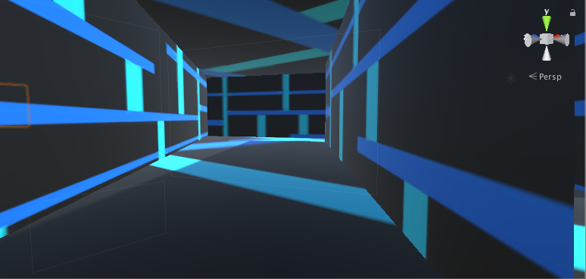
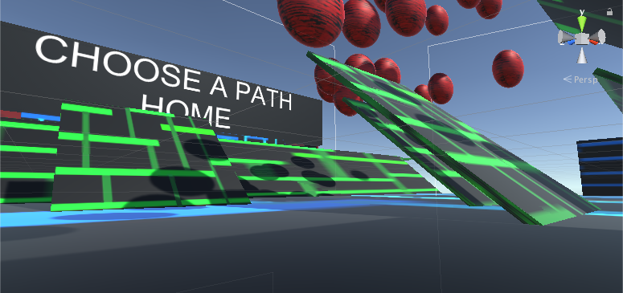
LABERINTH
PATHS

Slide 5
DEMO

Slide 6
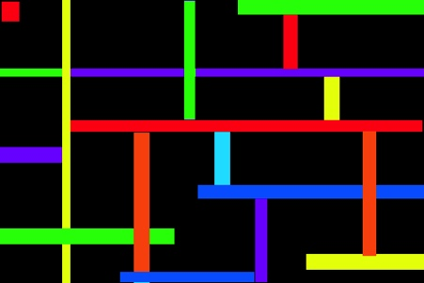
What went right
The second time we desiged our level we had in mind that we had to save the scene and the project without using the game mode.
Creating new textures to avoid copyright was a bold move
Our first codes were very good and worked
We adapted really good to our situation and our problems bringing viable and fast solutions
Having new ideas and being more creative with ideas and new mechanics

Slide 7
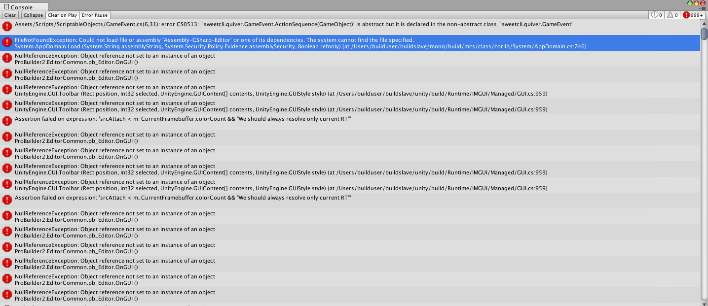
What went wrong
Many things did. Once a code was accidentally deleted so it broke the entire game giving us more than 999+ errors.Aproximatly 8 hours before assignment 2 delivery.
We had problems fixing that
like loosing our camara and
movement scripts bugging them
and having them stop working.
Problems using GitHub
A map was initially created however this one literally vanished because play mode was active.

Slide 8
WHAT WE LEARNT
To programm a code, and implement it to a game and an object
To design a videogame
To draw and create textures
To edit with play mode deactivated
Creating fast and good solutions for the things

Slide 9
Future updates
Add parts of the map that destroy you like spikes or holes
Add an expansion with slides and obstacles in order to give the jump controller more importance
Having more textures and a musical theme to be in the game itself
Adding an easter egg.
A dash button
Better textures
Another skybox.
Time record
More levels

